Slide 1
Chapter 3:
Pairwise Sequence Alignment
Jonathan Pevsner, Ph.D.
pevsner@kennedykrieger.org
Bioinformatics and Functional Genomics
(Wiley-Liss, 3rd edition, 2015)
You may use this PowerPoint for teaching purposes

Slide 2
Learning objectives
Upon completion of this material , you should be able to:
define homology as well as orthologs and paralogs;
explain how PAM (accepted point mutation) matrices are derived;
contrast the utility of PAM and BLOSUM scoring matrices;
define dynamic programming and explain how global (Needleman–Wunsch) and local (Smith–Waterman) pairwise alignments are performed; and
perform pairwise alignment of protein or DNA sequences at the NCBI website.

Slide 3
Outline
Introduction
Protein alignment: often more informative than DNA alignment
Definitions: homology, similarity, identity
Gaps
Pairwise alignment, homology, and evolution of life
ScorIng matrices
Dayhoff model: 7 steps
Pairwise alignment and limits of detection: the “twilight zone”
AlIgnment algorithms: global and local
Global sequence alignment: algorithm of Needleman and Wunsch
Local sequence alignment: Smith and Waterman algorithm
Rapid, heuristic versions of Smith–Waterman: FASTA and BLAST
Basic Local Alignment Search Tool (BLAST)
Pairwise alignment with dotplots
The statistical significance of pairwise alignments
Statistical significance of global alignments
Percent identity and relative entropy
Perspective

Slide 4
Pairwise sequence alignment is the most
fundamental operation of bioinformatics
• It is used to decide if two proteins (or genes) are related structurally or functionally
• It is used to identify domains or motifs that are shared between proteins
It is the basis of BLAST searching
• It is used in the analysis of genomes
B&FG 3e
Page 69

Slide 5
Sequence alignment: protein sequences
can be more informative than DNA
• protein is more informative (20 vs 4 characters);
many amino acids share related biophysical properties
• codons are degenerate: changes in the third position
often do not alter the amino acid that is specified
• protein sequences offer a longer “look-back” time
Example: --searching for plant globins using human beta globin DNA yields no matches; --searching for plant globins using human beta globin
protein yields many matches
B&FG 3e
Page 70

Slide 6
Pairwise alignment: DNA sequences
can be more informative than protein
Many times, DNA alignments are appropriate
--to study noncoding regions of DNA
(e.g. introns or intergenic regions)
--to study DNA polymorphisms
--genome sequencing relies on DNA analysis
B&FG 3e
Page 70

Slide 7
Definition: pairwise alignment
Pairwise alignment
The process of lining up two sequences
to achieve maximal levels of identity
(and conservation, in the case of amino acid sequences)
for the purpose of assessing the degree of similarity
and the possibility of homology.
B&FG 3e
Page 70

Slide 8
Definitions: identity, similarity, conservation
Homology
Similarity attributed to descent from a common ancestor.
Identity The extent to which two (nucleotide or amino acid) sequences are invariant.
Similarity
The extent to which nucleotide or protein sequences are related. It is based upon identity plus conservation.
Conservation
Changes at a specific position of an amino acid or (less commonly, DNA) sequence that preserve the physico-chemical properties of the original residue.
B&FG 3e
Page 70

Slide 9
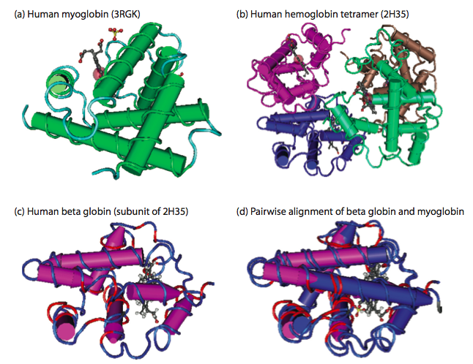
Globin homologs
myoglobin
hemoglobin
B&FG 3e
Fig. 3.1
Page 71
beta globin
beta globin and myoglobin (aligned)

Slide 10
Outline
Introduction
Protein alignment: often more informative than DNA alignment
Definitions: homology, similarity, identity
Gaps
Pairwise alignment, homology, and evolution of life
ScorIng matrices
Dayhoff model: 7 steps
Pairwise alignment and limits of detection: the “twilight zone”
AlIgnment algorithms: global and local
Global sequence alignment: algorithm of Needleman and Wunsch
Local sequence alignment: Smith and Waterman algorithm
Rapid, heuristic versions of Smith–Waterman: FASTA and BLAST
Basic Local Alignment Search Tool (BLAST)
Pairwise alignment with dotplots
The statistical significance of pairwise alignments
Statistical significance of global alignments
Percent identity and relative entropy
Perspective

Slide 11
Definitions: two types of homology
Orthologs
Homologous sequences in different species
that arose from a common ancestral gene
during speciation; may or may not be responsible
for a similar function.
Paralogs
Homologous sequences within a single species
that arose by gene duplication.
B&FG 3e
Fig. 2-3
Page 22

Slide 12
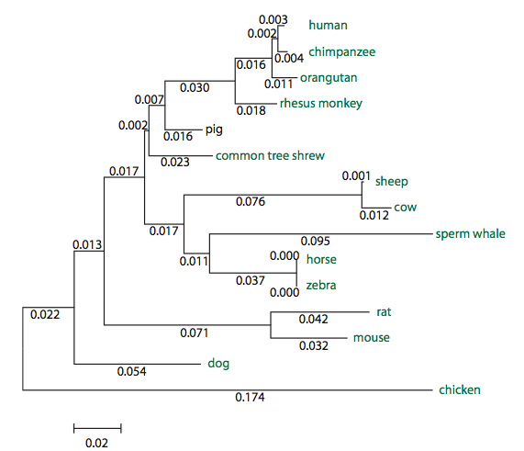
Myoglobin proteins: examples of orthologs
B&FG 3e
Fig. 3.2
Page 72
You can view the sequences at http://bioinfbook.org

Slide 13
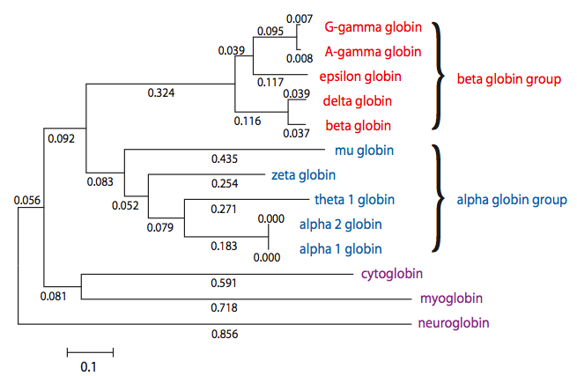
Paralogs: members of a gene (protein) family within a
species. This tree shows human globin paralogs.
B&FG 3e
Fig. 3.3
Page 73

Slide 14
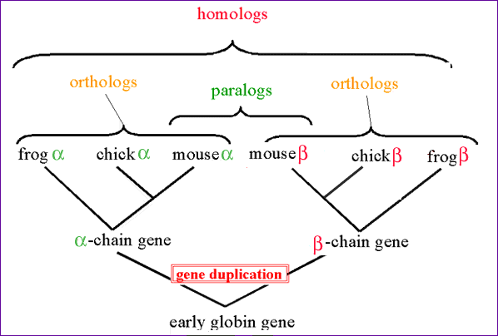
Orthologs and paralogs are often viewed in a single tree
Source: NCBI

Slide 15
General approach to pairwise alignment
Choose two sequences
Select an algorithm that generates a score
Allow gaps (insertions, deletions)
Score reflects degree of similarity
Alignments can be global or local
Estimate probability that the alignment occurred by chance

Slide 16
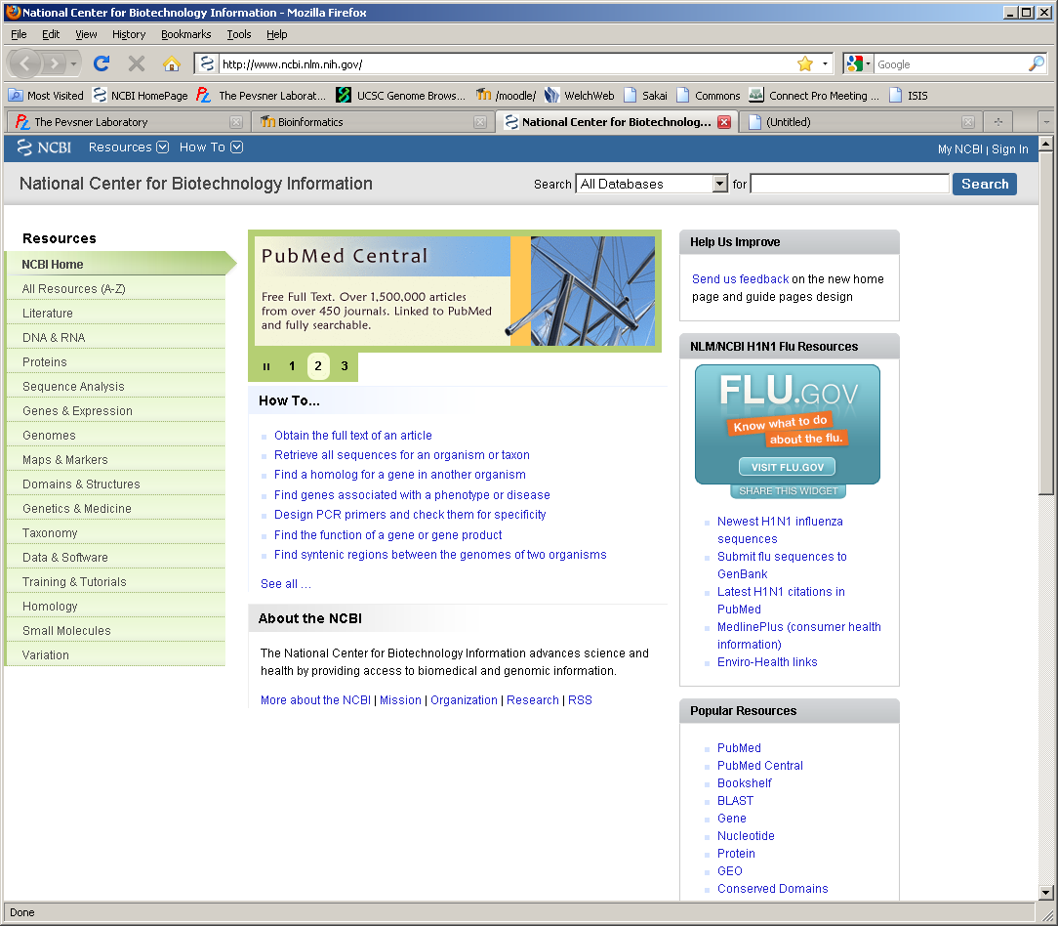
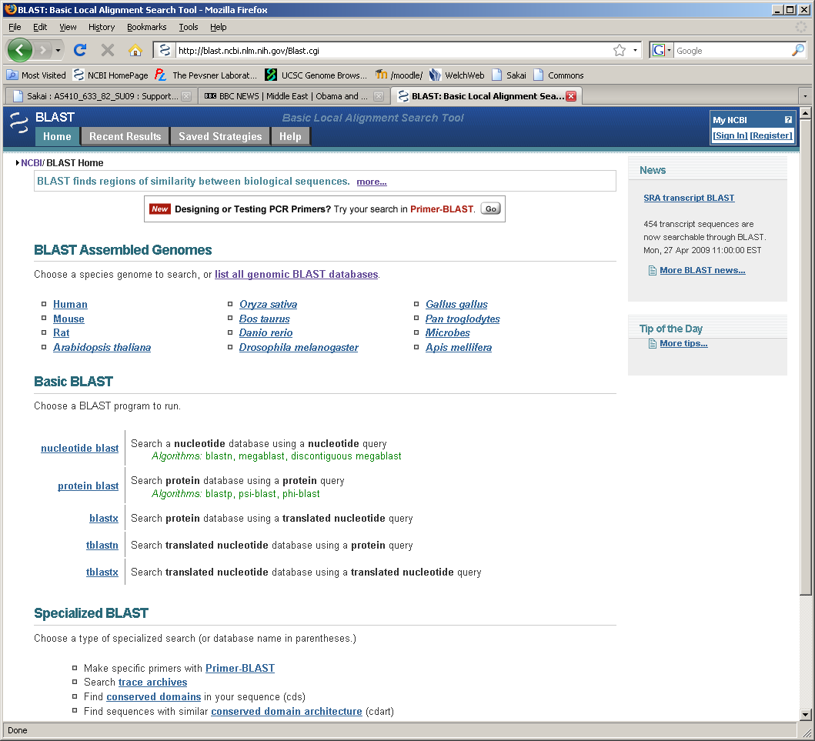
Find BLAST from the home page of NCBI and select protein BLAST…

Slide 17
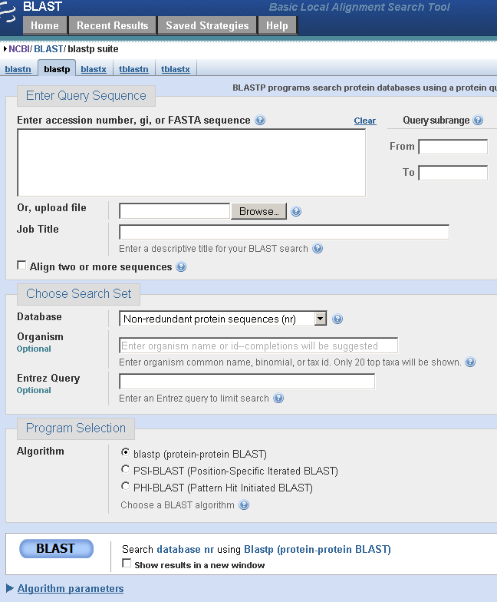
Choose align two or more sequences…

Slide 18
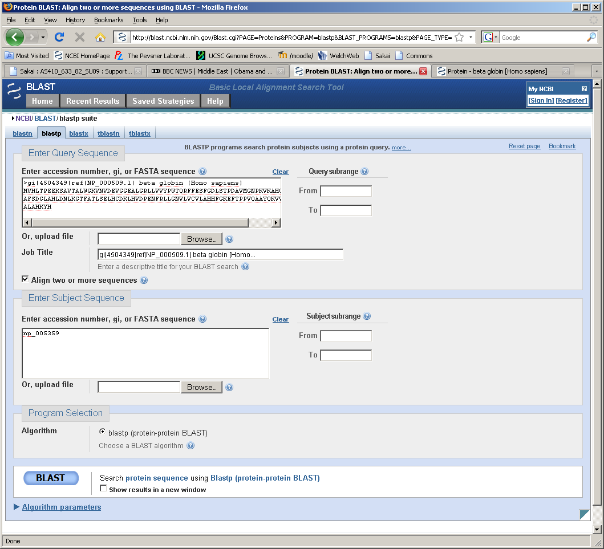
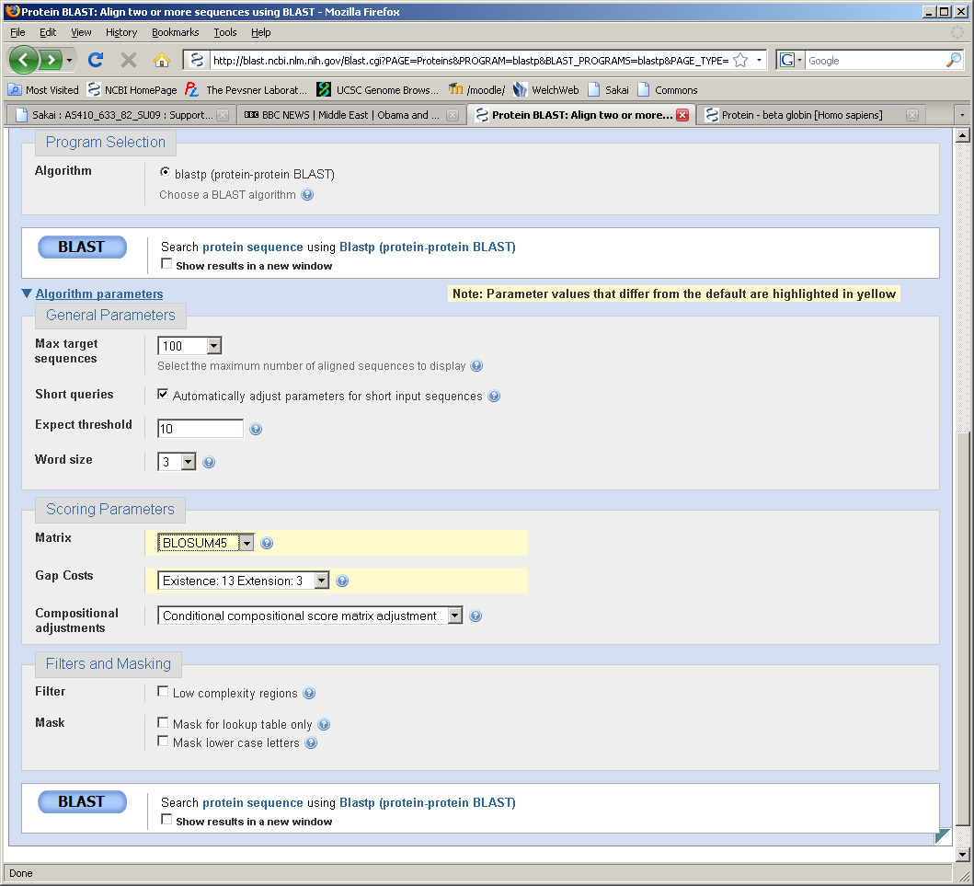
Enter the two sequences (as accession numbers or in the fasta format) and click BLAST.
Optionally select “Algorithm parameters” and note the matrix option.

Slide 19
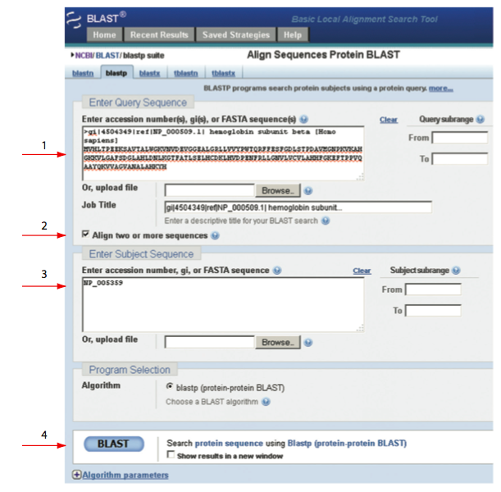
sequence
B&FG 3e
Fig. 3-4
Page 74
Year

Slide 20
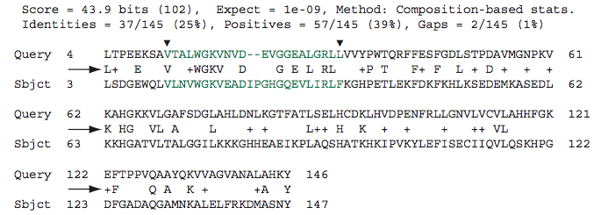
Pairwise alignment of human beta globin (the “query”) and myoglobin (the “subject”)
B&FG 3e
Fig. 3-5
Page 75
We’ll examine the highlighted green region of the alignment in more detail.

Slide 21
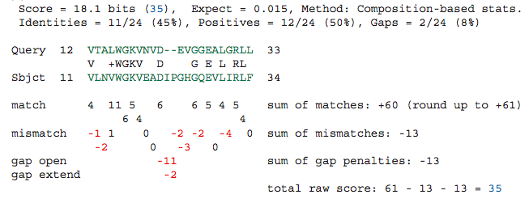
How raw scores are calculated: an example
For a set of aligned residues we assign scores based on matches, mismatches, gap open penalties, and gap extension penalties. These scores add up to the total raw score.
B&FG 3e
Fig. 3-5
Page 75

Slide 22
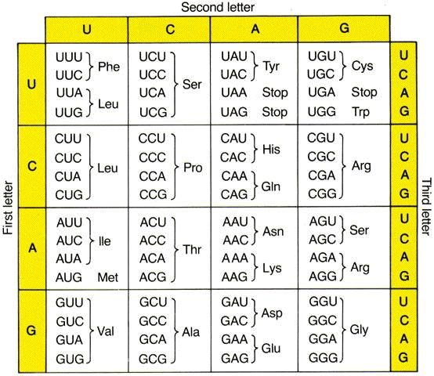
B&FG 3e
Box 3-6
Page 83

Slide 23
Where do scores come from? We’ll examine scoring matrices. These are related to the properties of the 20 common amino acids.
B&FG 3e
Box 3-6
Page 83

Slide 24
Outline
Introduction
Protein alignment: often more informative than DNA alignment
Definitions: homology, similarity, identity
Gaps
Pairwise alignment, homology, and evolution of life
ScorIng matrices
Dayhoff model: 7 steps
Pairwise alignment and limits of detection: the “twilight zone”
AlIgnment algorithms: global and local
Global sequence alignment: algorithm of Needleman and Wunsch
Local sequence alignment: Smith and Waterman algorithm
Rapid, heuristic versions of Smith–Waterman: FASTA and BLAST
Basic Local Alignment Search Tool (BLAST)
Pairwise alignment with dotplots
The statistical significance of pairwise alignments
Statistical significance of global alignments
Percent identity and relative entropy
Perspective

Slide 25
Gaps
• Positions at which a letter is paired with a null
are called gaps.
• Gap scores are typically negative.
• Since a single mutational event may cause the insertion
or deletion of more than one residue, the presence of
a gap is ascribed more significance than the length
of the gap. Thus there are separate penalties for gap creation and gap extension.
• In BLAST, it is rarely necessary to change gap values
from the default.

Slide 26
Outline
Introduction
Protein alignment: often more informative than DNA alignment
Definitions: homology, similarity, identity
Gaps
Pairwise alignment, homology, and evolution of life
ScorIng matrices
Dayhoff model: 7 steps
Pairwise alignment and limits of detection: the “twilight zone”
AlIgnment algorithms: global and local
Global sequence alignment: algorithm of Needleman and Wunsch
Local sequence alignment: Smith and Waterman algorithm
Rapid, heuristic versions of Smith–Waterman: FASTA and BLAST
Basic Local Alignment Search Tool (BLAST)
Pairwise alignment with dotplots
The statistical significance of pairwise alignments
Statistical significance of global alignments
Percent identity and relative entropy
Perspective

Slide 27
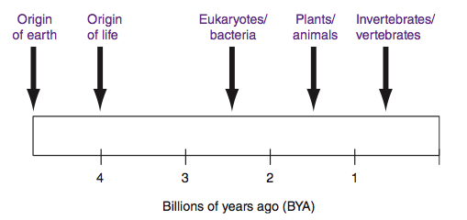
Pairwise alignment and the evolution of life
When two proteins (or DNA sequences) are homologous they share a common ancestor. We can infer the sequence of that ancestor. When we align globins from human and a plant we can imagine their common ancestor, a single celled organism that lived 1.5 billion years ago, and we can infer that ancient globin sequence. Through pairwise alignment we can look back in time at sequence evolution.
B&FG 3e
Fig. 3-6
Page 78

Slide 28
Outline
Introduction
Protein alignment: often more informative than DNA alignment
Definitions: homology, similarity, identity
Gaps
Pairwise alignment, homology, and evolution of life
Scoring matrices
Dayhoff model: 7 steps
Pairwise alignment and limits of detection: the “twilight zone”
Alignment algorithms: global and local
Global sequence alignment: algorithm of Needleman and Wunsch
Local sequence alignment: Smith and Waterman algorithm
Rapid, heuristic versions of Smith–Waterman: FASTA and BLAST
Basic Local Alignment Search Tool (BLAST)
Pairwise alignment with dotplots
The statistical significance of pairwise alignments
Statistical significance of global alignments
Percent identity and relative entropy
Perspective

Slide 29
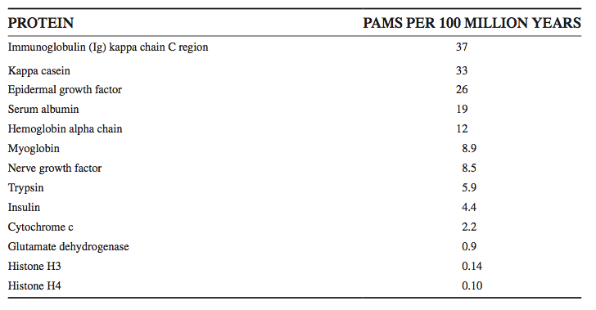
Step 1: Accepted point mutations (PAMs) in protein families
Margaret Dayhoff and colleagues developed scoring matrices in the 1960s and 1970s. They defined PAMs as “accepted point mutations.” Some protein families evolve very slowly (e.g. histones change little over 100 million years); others (such as kappa casein) change very rapidly.
B&FG 3e
Box 3-4
Page 77

Slide 30
Dayhoff’s 34 protein superfamilies
Protein PAMs per 100 million years
Ig kappa chain 37
Kappa casein 33
luteinizing hormone b 30
lactalbumin 27
complement component 3 27
epidermal growth factor 26
proopiomelanocortin 21
pancreatic ribonuclease 21
haptoglobin alpha 20
serum albumin 19
phospholipase A2, group IB 19
prolactin 17
carbonic anhydrase C 16
Hemoglobin a 12
Hemoglobin b 12

Slide 31
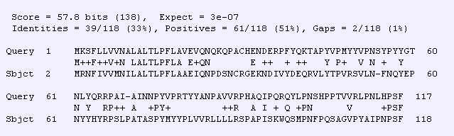
Dayhoff’s 34 protein superfamilies
Protein PAMs per 100 million years
Ig kappa chain 37
Kappa casein 33
luteinizing hormone b 30
lactalbumin 27
complement component 3 27
epidermal growth factor 26
proopiomelanocortin 21
pancreatic ribonuclease 21
haptoglobin alpha 20
serum albumin 19
phospholipase A2, group IB 19
prolactin 17
carbonic anhydrase C 16
Hemoglobin a 12
Hemoglobin b 12
human (NP_005203) versus mouse (NP_031812) kappa casein

Slide 32
Dayhoff’s 34 protein superfamilies
Protein PAMs per 100 million years
apolipoprotein A-II 10
lysozyme 9.8
gastrin 9.8
myoglobin 8.9
nerve growth factor 8.5
myelin basic protein 7.4
thyroid stimulating hormone b 7.4
parathyroid hormone 7.3
parvalbumin 7.0
trypsin 5.9
insulin 4.4
calcitonin 4.3
arginine vasopressin 3.6
adenylate kinase 1 3.2

Slide 33
Dayhoff’s 34 protein superfamilies
Protein PAMs per 100 million years
triosephosphate isomerase 1 2.8
vasoactive intestinal peptide 2.6
glyceraldehyde phosph. dehydrogease 2.2
cytochrome c 2.2
collagen 1.7
troponin C, skeletal muscle 1.5
alpha crystallin B chain 1.5
glucagon 1.2
glutamate dehydrogenase 0.9
histone H2B, member Q 0.9
ubiquitin 0

Slide 34
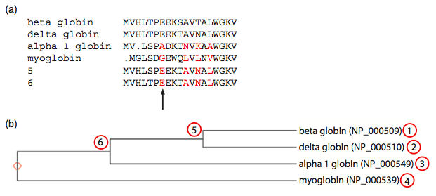
Step 1: accepted point mutations are defined not by the pairwise alignment but with respect to the common ancestor
Dayhoff et al. evaluated amino acid changes. They applied an evolutionary model to compare changes such as 1 versus 2 not to each other but to an inferred common ancestor at position 5.
B&FG 3e
Fig. 3-7
Page 80

Slide 35
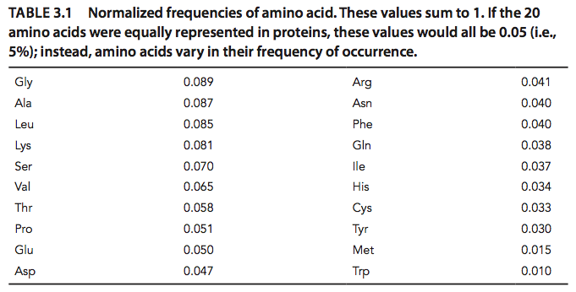
Dayhoff model step 2 (of 7): Frequency of amino acids
If 20 amino acids occurred in nature at equal frequencies, each would be observed 5% of the time. However some are more common (G, A, L, K) and some rare (C, Y, M, W).
B&FG 3e
Fig. 3-1
Page 81

Slide 36
Normalized frequencies of amino acids:
we need these values to calculate denominator p_{i}p_{j}
Gly 8.9% Arg 4.1%
Ala 8.7% Asn 4.0%
Leu 8.5% Phe 4.0%
Lys 8.1% Gln 3.8%
Ser 7.0% Ile 3.7%
Val 6.5% His 3.4%
Thr 5.8% Cys 3.3%
Pro 5.1% Tyr 3.0%
Glu 5.0% Met 1.5%
Asp 4.7% Trp 1.0%
blue=6 codons; red=1 codon in the genetic code
These frequencies f_{i} sum to 1

Slide 37
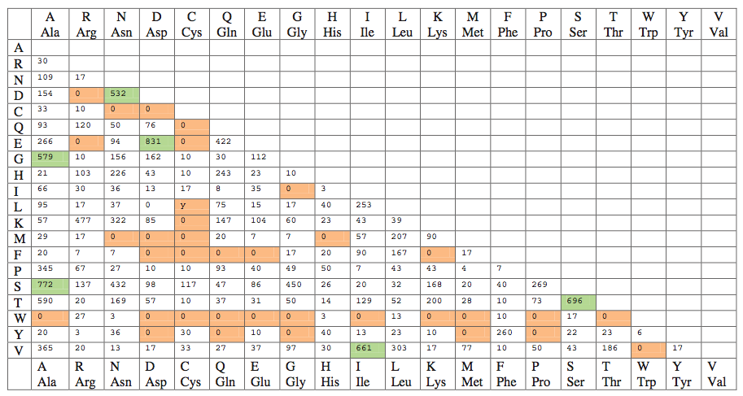
Dayhoff model step 3: amino acid substitutions
B&FG 3e
Fig. 3-8
Page 81
From a survey of 1572 observed substitutions, the original amino acid (columns) are compared to the changes (rows).

Slide 38
Dayhoff model step 3: amino acid substitutions
Zooming in on the previous table, note that substitutions are very common (e.g. D → E, A → G) while others are rare (e.g. C → Q, C → E). The scoring system we use for pairwise alignments should reflect these trends.
B&FG 3e
Fig. 3-8
Page 81

Slide 39
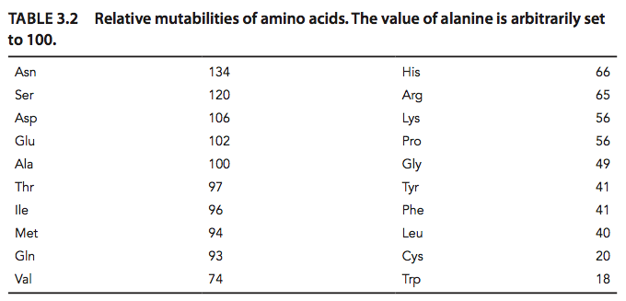
Dayhoff model step 3: Relative mutability of amino acids
Dayhoff et al. used (1) data on the frequency of amino acids and (2) data on observed and inferred numbers of substitutions to determine the relative mutability of amino acids. In a scoring system alignment of two tryptophans will be weighted more heavily than two asparagines.
B&FG 3e
Table 3-2
Page 82

Slide 40
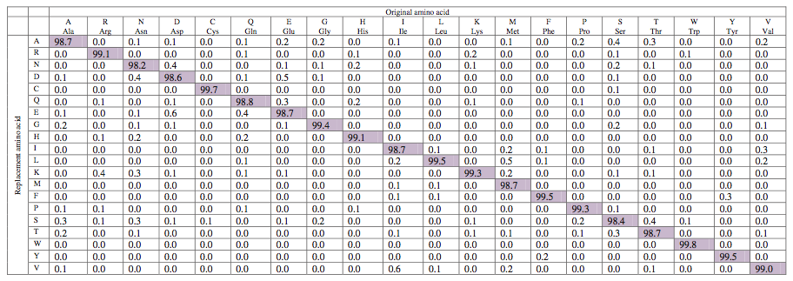
Dayhoff step 4 (of 7): Mutation probability matrix for the evolutionary distance of 1 PAM
This mutation probability matrix includes original amino acids (columns) and replacements (rows). The diagonals show that at a distance of 1 PAM most residues remain the same about 99% of the time (see shaded entries). Note how cysteine (C) and tryptophan (W) undergo few substitutions, and asparagine (N) many.
B&FG 3e
Fig. 3-9
Page 84

Slide 41
Substitution Matrix
A substitution matrix contains values proportional
to the probability that amino acid i mutates into
amino acid j for all pairs of amino acids.
Substitution matrices are constructed by assembling
a large and diverse sample of verified pairwise alignments
(or multiple sequence alignments) of amino acids.
Substitution matrices should reflect the true probabilities
of mutations occurring through a period of evolution.
The two major types of substitution matrices are
PAM and BLOSUM.

Slide 42
PAM matrices:
Point-accepted mutations
PAM matrices are based on global alignments
of closely related proteins.
The PAM1 is the matrix calculated from comparisons
of sequences with no more than 1% divergence. At an evolutionary interval of PAM1, one change has occurred over a length of 100 amino acids.
Other PAM matrices are extrapolated from PAM1. For PAM250, 250 changes have occurred for two proteins over a length of 100 amino acids.
All the PAM data come from closely related proteins
(>85% amino acid identity).

Slide 43
Dayhoff step 4 (of 7): Mutation probability matrix for the evolutionary distance of 1 PAM
At this evolutionary distance of 1 PAM, 1% of the amino acids have diverged between each pair of sequences. The columns are percentages that sum to 100%.
B&FG 3e
Fig. 3-9
Page 84

Slide 44
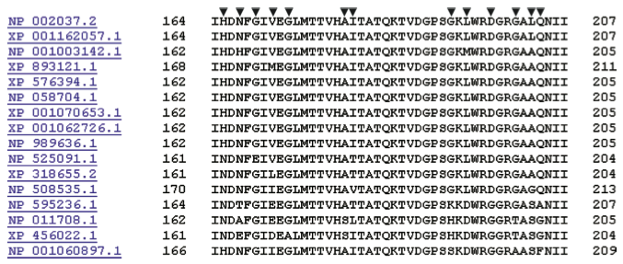
Dayhoff step 5 (of 7): PAM250 and other PAM matrices
Consider a multiple alignment of glyceraldehyde 3-phosphate protein sequences. Some substitutions are observed in columns (arrowheads). These give us insight into changes tolerated by natural selection.
B&FG 3e
Fig. 3-10
Page 85

Slide 45
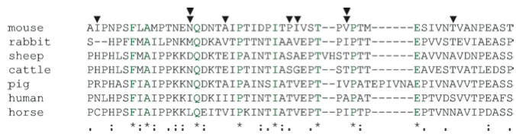
Dayhoff step 5 (of 7): PAM250 and other PAM matrices
Now consider the alignment of distantly related kappa caseins. There are few conserved column positions, and many some columns (double arrowheads) have five different residues among the 7 proteins. We want to design a scoring system that is tolerant of distantly related proteins: if the scoring system is too strict then the divergent sequences may be penalized so heavily that authentic homologs are not identified or aligned.
B&FG 3e
Fig. 3-11
Page 86

Slide 46
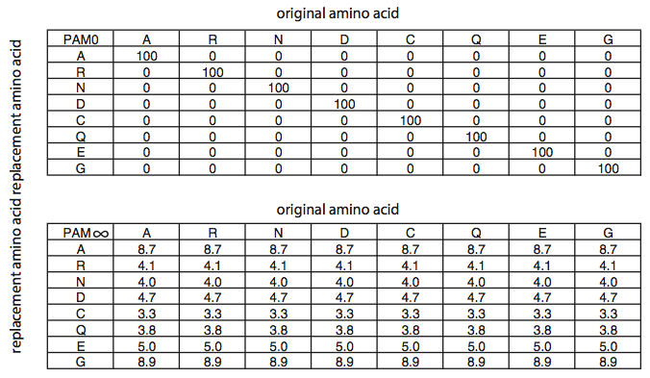
Dayhoff step 5 (of 7): PAM250 and other PAM matrices
At the extreme of perfectly conserved proteins (PAM0) there are no amino acid replacements. At the extreme of completely diverged proteins (PAM∞) the matrix converges on the background frequencies of the amino acids.
B&FG 3e
Fig. 3-12
Page 86

Slide 47
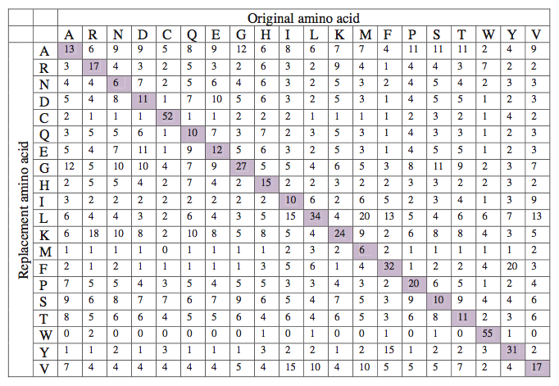
PAM250 matrix: for proteins that share ~20% identity
B&FG 3e
Fig. 3-13
Page 88
Compare this to a PAM1 matrix, and note the diagonal still has high scores but much information content is lost.

Slide 48
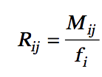
Dayhoff step 6 (of 7): from a mutation probability matrix to a relatedness odds matrix
A relatedness odds matrix reports the probability that amino acid j will change to i in a homologous sequence.
The numerator models the observed change. The denominator fi is the probability of amino acid residue i occurring in the second sequence by chance.
A positive value indicates a replacement happens more often than expected by chance. A negative value indicates the replacement is not favored.
B&FG 3e
Eq. 3-3
Page 88

Slide 49
Why do we go from a mutation probability
matrix to a log odds matrix?
We want a scoring matrix so that when we do a pairwise
alignment (or a BLAST search) we know what score to
assign to two aligned amino acid residues.
Logarithms are easier to use for a scoring system. They
allow us to sum the scores of aligned residues (rather
than having to multiply them).

Slide 50
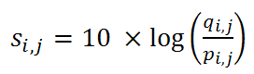
How do we go from a mutation probability
matrix to a log odds matrix?
The cells in a log odds matrix consist of an “odds ratio”:
the probability that an alignment is authentic
the probability that the alignment was random
The score S for an alignment of residues a,b is given by:
S(a,b) = 10 log₁₀ (M_{ab}/p_{b})
As an example, for tryptophan,
S(trp,trp) = 10 log₁₀ (0.55/0.010) = 17.4

Slide 51
What do the numbers mean
in a log odds matrix?
A score of +2 indicates that the amino acid replacement
occurs 1.6 times as frequently as expected by chance.
A score of 0 is neutral.
A score of –10 indicates that the correspondence of two
amino acids in an alignment that accurately represents
homology (evolutionary descent) is one tenth as frequent
as the chance alignment of these amino acids.

Slide 52
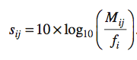
Dayhoff step 7 (of 7): log odds scoring matrix
A log odds matrix is the logarithmic form of the relatedness odds matrix. sij is the score for aligning any two residues in a pairwise alignment. (There is also a score for aligning a residue with itself.) Mij is of the observed frequency of substitutions for each pair of amino acids. These values (“target frequencies”) are derived from a mutation probability matrix.
B&FG 3e
Eq. 3-4
Page 89

Slide 53
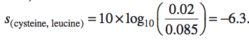
Example of a score for aligning cysteine and leucine using the values in a PAM250 scoring matrix
B&FG 3e
Eq. 3-5
Page 89

Slide 54
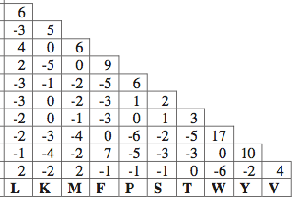
Log-odds matrix for PAM250
This is a useful matrix for comparing distantly related proteins. Note that an alignment of two tryptophan (W) residues earns +17 and a W to T mismatch is -5.
B&FG 3e
Fig. 3-14
Page 90

Slide 55
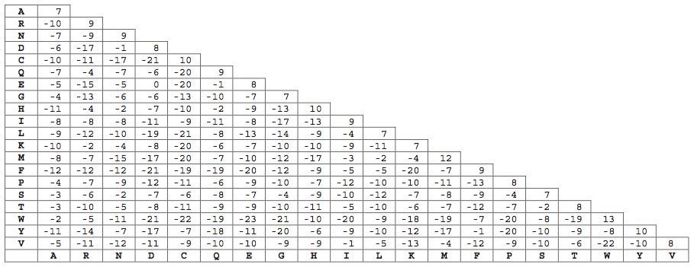
Log-odds matrix for PAM10
This is an example of a scoring matrix with “severe” penalties. A match of W to W earns +13, but a mismatch (e.g. W aligned to T) has a score of -19, far lower than in PAM250.
B&FG 3e
Fig. 3-15
Page 91

Slide 56
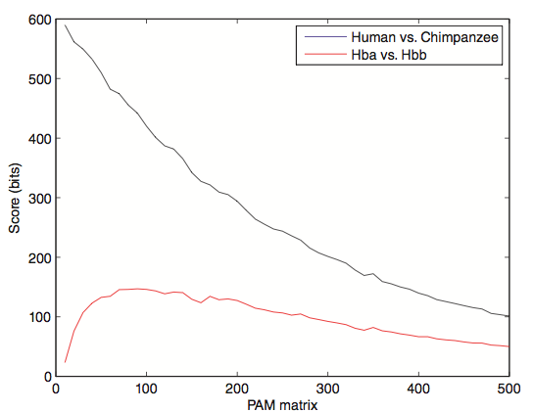
Effect of scoring matrix on bit scores
Look at score for distantly related proteins (e.g. beta globin versus alpha globin) and note that PAM10 or similar matrices assign very low scores. This effect is not seen for very closely related proteins (e.g. a chimp vs. human globin).
B&FG 3e
Fig. 3-16
Page 92

Slide 57
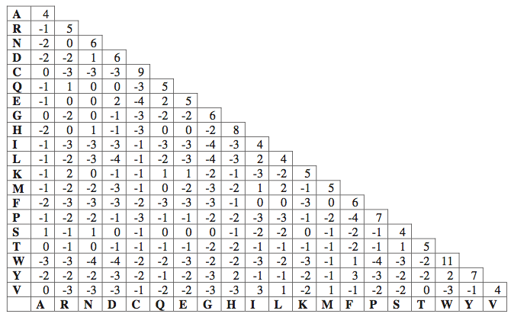
BLOSUM62 scoring matrix
B&FG 3e
Fig. 3-17
Page 93
BL62 is the default scoring matrix at the NCBI BLAST site.

Slide 58
BLOSUM Matrices
BLOSUM matrices are based on local alignments.
All BLOSUM matrices are based on observed alignments;
they are not extrapolated from comparisons of
closely related proteins.
BLOSUM stands for blocks substitution matrix.
BLOSUM62 is a matrix calculated from comparisons of
sequences with no less than 62% divergence.
BLOSUM62 is the default matrix in BLAST 2.0.
Notes:
58

Slide 59
BLOSUM Matrices
100
collapse
62
Percent amino acid identity
30
BLOSUM62
Notes:
59

Slide 60
BLOSUM Matrices
100
collapse
100
100
collapse
62
62
62
collapse
Percent amino acid identity
30
30
30
BLOSUM80
BLOSUM62
BLOSUM30
Notes:
60

Slide 61
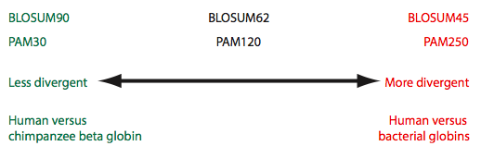
Summary of PAM and BLOSUM matrices
A higher PAM number, and a lower BLOSUM number, tends to correspond to a matrix tuned to more divergent proteins.
B&FG 3e
Fig. 3-18
Page 94

Slide 62
Outline
Introduction
Protein alignment: often more informative than DNA alignment
Definitions: homology, similarity, identity
Gaps
Pairwise alignment, homology, and evolution of life
Scoring matrices
Dayhoff model: 7 steps
Pairwise alignment and limits of detection: the “twilight zone”
Alignment algorithms: global and local
Global sequence alignment: algorithm of Needleman and Wunsch
Local sequence alignment: Smith and Waterman algorithm
Rapid, heuristic versions of Smith–Waterman: FASTA and BLAST
Basic Local Alignment Search Tool (BLAST)
Pairwise alignment with dotplots
The statistical significance of pairwise alignments
Statistical significance of global alignments
Percent identity and relative entropy
Perspective

Slide 63
PAM matrices: Point-accepted mutations
PAM matrices are based on global alignments
of closely related proteins.
The PAM1 is the matrix calculated from comparisons
of sequences with no more than 1% divergence. At an evolutionary interval of PAM1, one change has occurred over a length of 100 amino acids.
Other PAM matrices are extrapolated from PAM1. For PAM250, 250 changes have occurred for two proteins over a length of 100 amino acids.
All the PAM data come from closely related proteins
(>85% amino acid identity).
Notes:
63

Slide 64
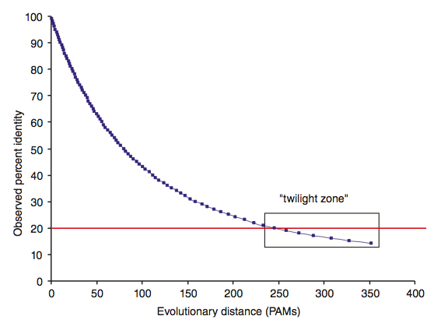
Two randomly diverging protein sequences change
in a negatively exponential fashion
At PAM1, two proteins are 99% identical
At PAM10.7, there are 10 differences per 100 residues
At PAM80, there are 50 differences per 100 residues
At PAM250, there are 80 differences per 100 residues
B&FG 3e
Fig. 3-19
Page 95

Slide 65
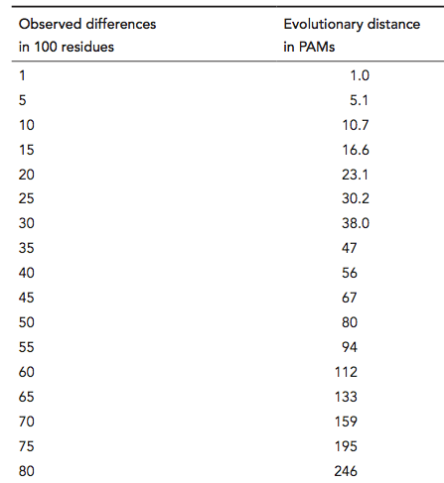
Correspondence between observed differences (per 100 residues) and evolutionary distance (in PAMs)
PAM 80
B&FG 3e
Table 3-3
Page 95
PAM 250

Slide 66
Outline
Introduction
Protein alignment: often more informative than DNA alignment
Definitions: homology, similarity, identity
Gaps
Pairwise alignment, homology, and evolution of life
Scoring matrices
Dayhoff model: 7 steps
Pairwise alignment and limits of detection: the “twilight zone”
Alignment algorithms: global and local
Global sequence alignment: algorithm of Needleman and Wunsch
Local sequence alignment: Smith and Waterman algorithm
Rapid, heuristic versions of Smith–Waterman: FASTA and BLAST
Basic Local Alignment Search Tool (BLAST)
Pairwise alignment with dotplots
The statistical significance of pairwise alignments
Statistical significance of global alignments
Percent identity and relative entropy
Perspective

Slide 67
Two kinds of sequence alignment: global and local
We will first consider the global alignment algorithm
of Needleman and Wunsch (1970).
We will then explore the local alignment algorithm
of Smith and Waterman (1981).
Finally, we will consider BLAST, a heuristic version
of Smith-Waterman.
Notes:
67

Slide 68
Global alignment with the algorithm
of Needleman and Wunsch (1970)
• Two sequences can be compared in a matrix
along x- and y-axes.
• If they are identical, a path along a diagonal
can be drawn
• Find the optimal subpaths, and add them up to achieve
the best score. This involves
--adding gaps when needed
--allowing for conservative substitutions
--choosing a scoring system (simple or complicated)
N-W is guaranteed to find optimal alignment(s)
Notes:
68

Slide 69
Three steps to global alignment
with the Needleman-Wunsch algorithm
[1] set up a matrix
[2] score the matrix
[3] identify the optimal alignment(s)
Notes:
69

Slide 70
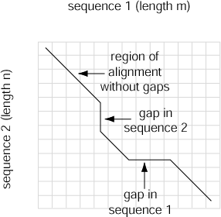
Four possible outcomes in aligning two sequences
[1] identity (stay along a diagonal)
[2] mismatch (stay along a diagonal)
[3] gap in one sequence (move vertically!)
[4] gap in the other sequence (move horizontally!)
B&FG 3e
Fig. 3-20
Page 97
Notes:
70

Slide 71
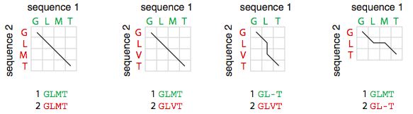
Four possible outcomes in aligning two sequences
B&FG 3e
Fig. 3-20
Page 97

Slide 72
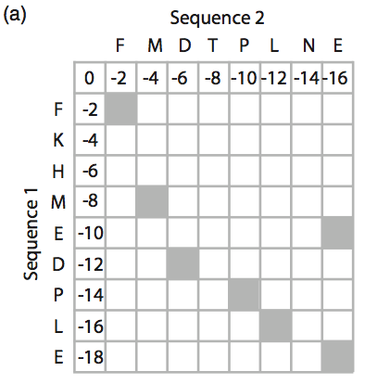
Global pairwise alignment using Needleman-Wunsch
B&FG 3e
Fig. 3-21
Page 98
Identify positions of identity (shaded gray).

Slide 73
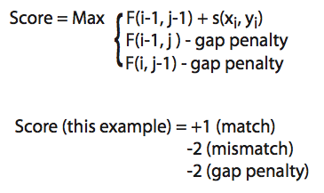
Global pairwise alignment using Needleman-Wunsch
Define an overall score that maximizes cumulative scores at each position of the pairwise alignment, allowing for substitutions and gaps in either sequence.
B&FG 3e
Fig. 3-21
Page 98

Slide 74
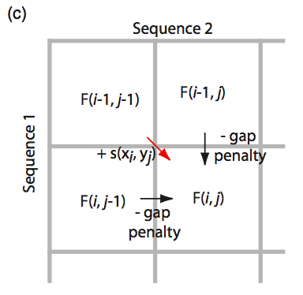
Global pairwise alignment using Needleman-Wunsch
To decide how to align sequences 1 and 2 in the box at lower right, decide what the scores are beginning at upper left (not requiring a gap), or beginning from the left or top (each requiring a gap penalty).
B&FG 3e
Fig. 3-21
Page 98

Slide 75
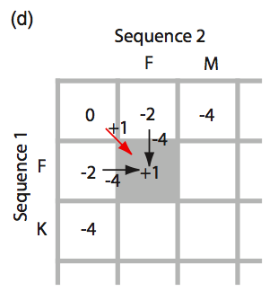
Global pairwise alignment using Needleman-Wunsch
Here the best score involves +1 (proceed from upper left to gray, lower right square). If we instead select an alignment involving a gap the score would be worse (-4).
B&FG 3e
Fig. 3-21
Page 98

Slide 76
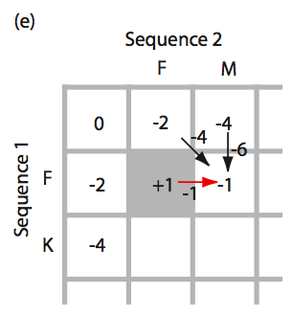
Global pairwise alignment using Needleman-Wunsch
B&FG 3e
Fig. 3-21
Page 98
Proceed to calculate the optimal score for the next position.

Slide 77
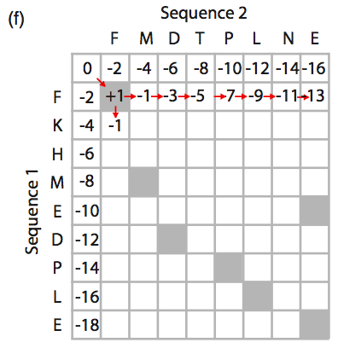
Global pairwise alignment using Needleman-Wunsch
B&FG 3e
Fig. 3-21
Page 98
Continue filling in the matrix.

Slide 78
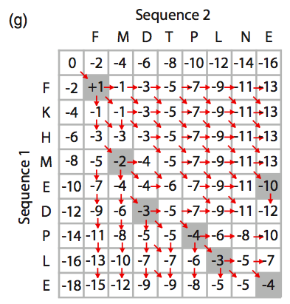
Global pairwise alignment using Needleman-Wunsch
B&FG 3e
Fig. 3-21
Page 98
Complete filling in the matrix.

Slide 79
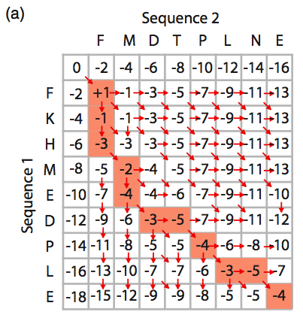
Global pairwise alignment using Needleman-Wunsch
B&FG 3e
Fig. 3-22
Page 100
Highlighted cells indicate the optimal path (best scores), indicating how the two sequences should be aligned.

Slide 80
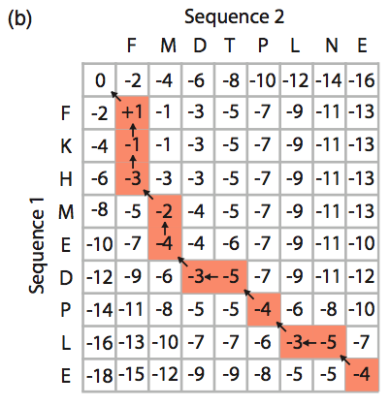
Global pairwise alignment using Needleman-Wunsch
B&FG 3e
Fig. 3-22
Page 100
Equivalent representation, showing the traceback procedure: begin at the lower right cell and proceed back to the start.

Slide 81
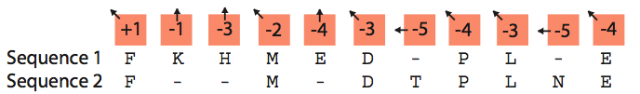
Global pairwise alignment using Needleman-Wunsch
B&FG 3e
Fig. 3-22
Page 100
Equivalent representation, showing the traceback procedure: begin at the lower right cell and proceed back to the start.

Slide 82
Needleman-Wunsch: dynamic programming
N-W is guaranteed to find optimal alignments, although
the algorithm does not search all possible alignments.
It is an example of a dynamic programming algorithm:
an optimal path (alignment) is identified by
incrementally extending optimal subpaths.
Thus, a series of decisions is made at each step of the
alignment to find the pair of residues with the best score.
Notes:
82

Slide 83
Global alignment versus local alignment
Global alignment (Needleman-Wunsch) extends
from one end of each sequence to the other.
Local alignment finds optimally matching
regions within two sequences (“subsequences”).
Local alignment is almost always used for database
searches such as BLAST. It is useful to find domains
(or limited regions of homology) within sequences.
Smith and Waterman (1981) solved the problem of
performing optimal local sequence alignment. Other
methods (BLAST, FASTA) are faster but less thorough.
Notes:
83

Slide 84
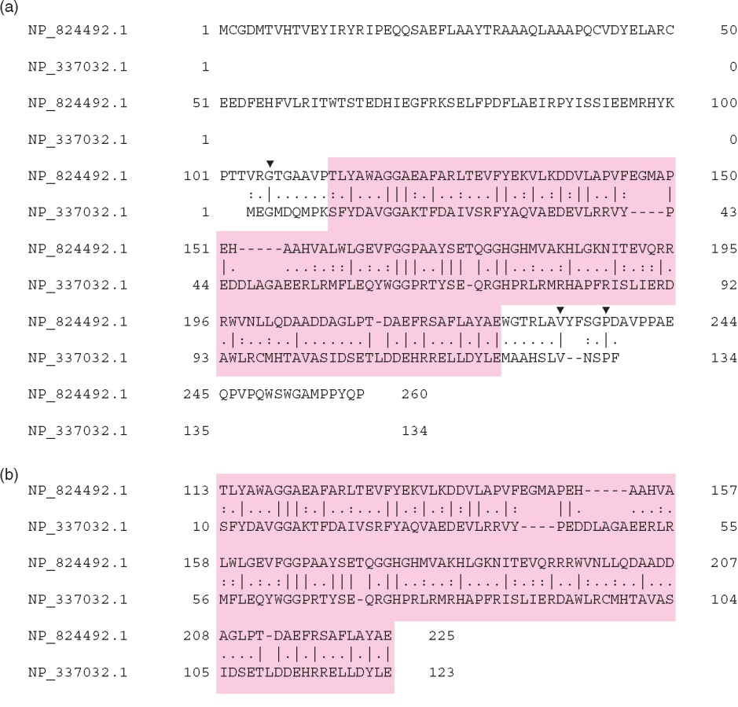
Global alignment (top) includes matches
ignored by local alignment (bottom)
Global:
15% identity
Local:
30% identity
B&FG 3e
Fig. 3-23
Page 101
NP_824492, NP_337032

Slide 85
Outline
Introduction
Protein alignment: often more informative than DNA alignment
Definitions: homology, similarity, identity
Gaps
Pairwise alignment, homology, and evolution of life
Scoring matrices
Dayhoff model: 7 steps
Pairwise alignment and limits of detection: the “twilight zone”
Alignment algorithms: global and local
Global sequence alignment: algorithm of Needleman and Wunsch
Local sequence alignment: Smith and Waterman algorithm
Rapid, heuristic versions of Smith–Waterman: FASTA and BLAST
Basic Local Alignment Search Tool (BLAST)
Pairwise alignment with dotplots
The statistical significance of pairwise alignments
Statistical significance of global alignments
Percent identity and relative entropy
Perspective

Slide 86
How the Smith-Waterman algorithm works
Set up a matrix between two proteins (size m+1, n+1)
No values in the scoring matrix can be negative! S > 0
The score in each cell is the maximum of four values:
[1] s(i-1, j-1) + the new score at [i,j] (a match or mismatch)
[2] s(i,j-1) – gap penalty
[3] s(i-1,j) – gap penalty
[4] zero ← this is not in Needleman-Wunsch
Notes:
86

Slide 87
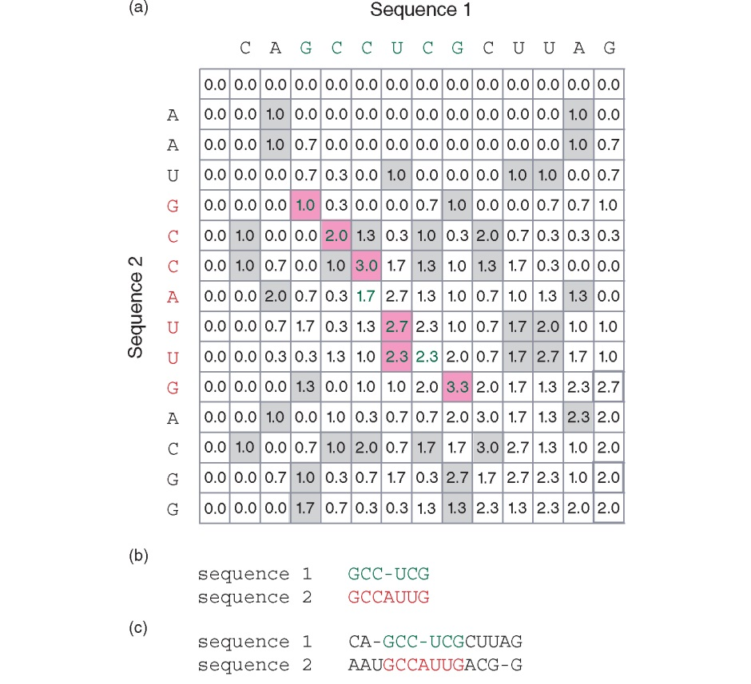
How the Smith-Waterman algorithm works
B&FG 3e
Fig. 3-24
Page 102

Slide 88
Where to use the Smith-Waterman algorithm
[1] Galaxy offers “needle” and “water” EMBOSS programs.
[2] EBI offers needle and water. http://www.ebi.ac.uk/Tools/psa/
[3] Try using SSEARCH to perform a rigorous Smith-Waterman local alignment:
http://fasta.bioch.virginia.edu/
[4] Next-generation sequence aligners incorporate Smith-Waterman in some specialized steps.
Notes:
88

Slide 89
Rapid, heuristic versions of Smith-Waterman:
FASTA and BLAST
Smith-Waterman is very rigorous and it is guaranteed
to find an optimal alignment.
But Smith-Waterman is slow. It requires computer
space and time proportional to the product of the two
sequences being aligned (or the product of a query
against an entire database).
Gotoh (1982) and Myers and Miller (1988) improved the
algorithms so both global and local alignment require
less time and space.
FASTA and BLAST provide rapid alternatives to S-W. We cover BLAST in Chapters 4 and 5.
Notes:
89

Slide 90
Outline
Introduction
Protein alignment: often more informative than DNA alignment
Definitions: homology, similarity, identity
Gaps
Pairwise alignment, homology, and evolution of life
Scoring matrices
Dayhoff model: 7 steps
Pairwise alignment and limits of detection: the “twilight zone”
Alignment algorithms: global and local
Global sequence alignment: algorithm of Needleman and Wunsch
Local sequence alignment: Smith and Waterman algorithm
Rapid, heuristic versions of Smith–Waterman: FASTA and BLAST
Basic Local Alignment Search Tool (BLAST)
Pairwise alignment with dotplots
The statistical significance of pairwise alignments
Statistical significance of global alignments
Percent identity and relative entropy
Perspective

Slide 91

Pairwise alignment with dotplots
B&FG 3e
Fig. 3-25
Page 105
A human globin searched against itself produces a unit diagonal on a dot plot (NCBI BLASTP, aligning 2 sequences).

Slide 92
Pairwise alignment with dotplots
Search human cytoglobin against a large snail globin (having many globin repeats). More repeats are observed using PAM250 than BLOSUM62.
To “read” this plot note that cytoglobin (x-axis) matches the snail globin (y-axis) at about a dozen locations across the snail protein. Red arrows indicate that the first few and last few amino acids of cytoglobin do not participate in this repeat structure.
B&FG 3e
Fig. 3-25
Page 105

Slide 93

Pairwise alignment with dotplots
BLASTP output includes the various sequence alignments. One is shown here: human cytoglobin (residues 18-154) aligns to the snail globin (at residues 1529-1669). The expect value is convincing (4e-13), and this is one of a dozen sequence alignments.
Conclusion: the dotplot is an excellent way to visualize complex repeats.
B&FG 3e
Fig. 3-25
Page 105

Slide 94
Outline
Introduction
Protein alignment: often more informative than DNA alignment
Definitions: homology, similarity, identity
Gaps
Pairwise alignment, homology, and evolution of life
Scoring matrices
Dayhoff model: 7 steps
Pairwise alignment and limits of detection: the “twilight zone”
Alignment algorithms: global and local
Global sequence alignment: algorithm of Needleman and Wunsch
Local sequence alignment: Smith and Waterman algorithm
Rapid, heuristic versions of Smith–Waterman: FASTA and BLAST
Basic Local Alignment Search Tool (BLAST)
Pairwise alignment with dotplots
The statistical significance of pairwise alignments
Statistical significance of global alignments
Percent identity and relative entropy
Perspective

Slide 95

Statistical significance of pairwise alignments
Sensitivity = TP / (TP + FN)
Specificity = TN / (TN + FP)
B&FG 3e
Fig. 3-26
Page 106

Slide 96

Statistical significance of pairwise alignments
The statistical significance of global alignments is not well described. We can apply a z-score.
For local alignment the statistical significance is thoroughly understood. See Chapter 4 (BLAST).
B&FG 3e
Fig. 3-26
Page 106

Slide 97
Outline
Introduction
Protein alignment: often more informative than DNA alignment
Definitions: homology, similarity, identity
Gaps
Pairwise alignment, homology, and evolution of life
Scoring matrices
Dayhoff model: 7 steps
Pairwise alignment and limits of detection: the “twilight zone”
Alignment algorithms: global and local
Global sequence alignment: algorithm of Needleman and Wunsch
Local sequence alignment: Smith and Waterman algorithm
Rapid, heuristic versions of Smith–Waterman: FASTA and BLAST
Basic Local Alignment Search Tool (BLAST)
Pairwise alignment with dotplots
The statistical significance of pairwise alignments
Statistical significance of global alignments
Percent identity and relative entropy
Perspective

Slide 98

Relative entropy (H) as a function of PAM distance
For PAM matrices with low values (e.g. PAM10) the relative entropy (in bits) is high and the minimum alignment length needed to detect a significant pairwise alighment is short. Relative entropy relates to the information content.
For PAM250 and similar matrices the relative entropy is low. It is necessary to have a longer region of amino acids aligned (e.g. 80 residues) to detect significant pairwise relatedness.
B&FG 3e
Fig. 3-27
Page 109

Slide 99
Perspective
Pairwise alignment is a fundamental problem in bioinformatics. We discussed concepts of homology, and global versus local alignment (e.g. Needleman-Wunsch versus Smith-Waterman algorithms).

Slide 100

We end with a remarkable scoring matrix reported by Zuckerkandl and Pauling in 1965, soon after the very first protein sequences were identified. While the data set was very sparse, these authors already found patterns of amino acid substitutions that occur in nature.
B&FG 3e
Fig. 3-28
Page 111

